Slide 1


FatBit
Chandler DeLoach, Ethan Hendrix, Jayse White

Slide 2
What is the fatbit?
The fatbit is a health tracker which revolutionizes the health tracker industry by doing everything a Fitbit already does, while also appealing to people who think it’s funny to wear a fitness tracker called a “fatbit”

Slide 3
Requirements
Functional
Count steps
Track user heart rate
Calculate calories burned
Display current time
Non-Functional
Efficient utilization of resources
Operate on a device with limited memory space
Information viewable on small screen
Clean display aesthetic

Slide 4
Analysis
Calculate calories
Based on heart rate
Implemented GUI in Java Swing
Minimal buttons for clean interface
Tested in small window
Generic approach with Interfaces
Data source interface
Log as a parent class
Each log in our FatBit is a child of the parent log class
Notes:
We originally we going to have an active/inactive mode and calculate calories off of that, but we ended up moving towards basing this off of heart rate, because it made more sense.

Slide 5
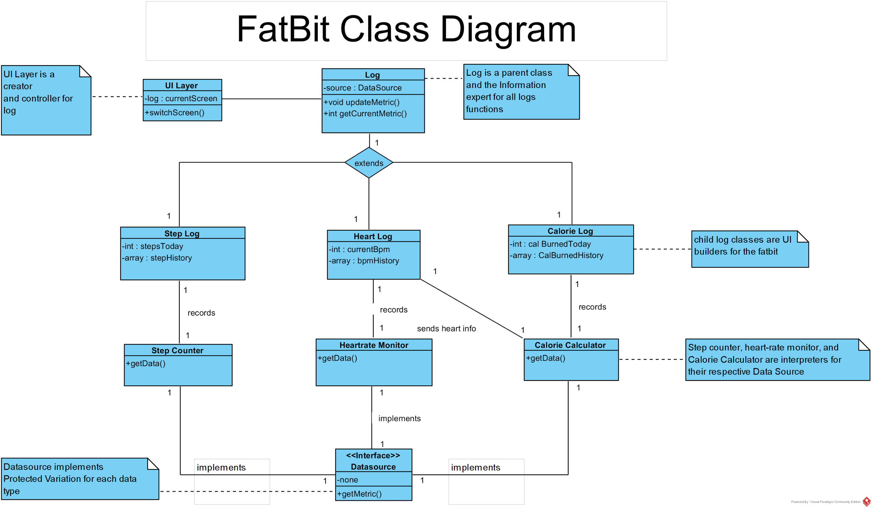

Slide 6
Design Patterns
Log
Information Expert
Each log is responsible for knowing its values (i.e. HeartRate log knows the heart rate)
Builder
Each log is responsible for building its corresponding UI element
UILayer
Controller
The UILayer handles system events and responds accordingly to user input
Datasource Interface
Adapter
The interface simplifies the communication and allows the pieces to talk to each other

Slide 7
What went right
For the most part, we stuck to our class diagram
Design patterns are utilized to an extent
UI fulfills nonfunctional requirements
Our code works!

Slide 8
What went wrong
Our implementation violates Model-View-Controller
Our graphics don’t look quite right on all platforms
Questionable cohesion with Log’s children

Slide 9
FatBit Demo

Slide 10
Questions?

